Slide 1

SMART PARKING BASED ON [IOT]

Slide 2


Slide 3
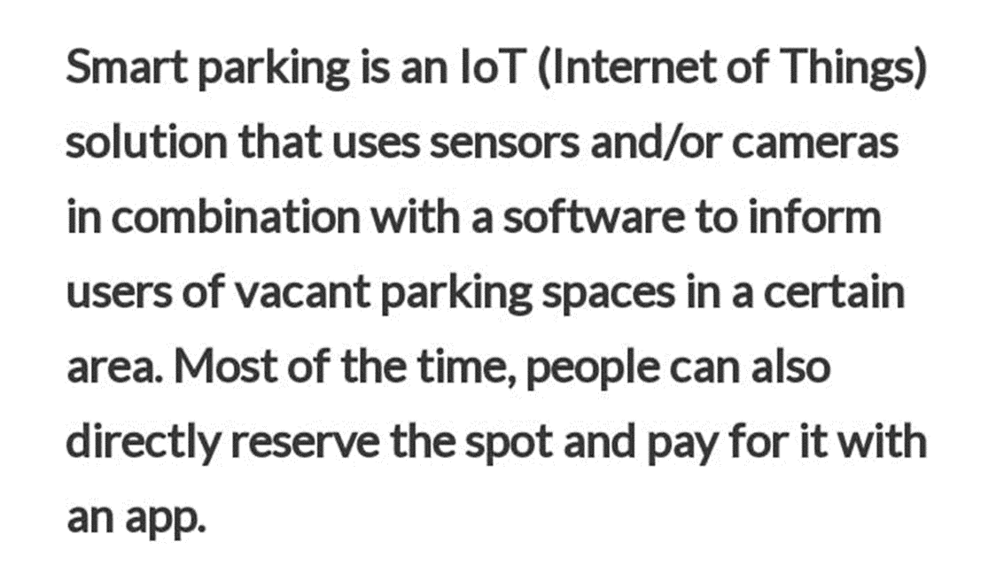
INTRODUCTION:

Slide 4
CONTENT:
TOPIC
INTRODUCTION
DEFINITION
DESIGN THINKING
PROJECT OBJECTIVES
IOT SENSOR DESIGN
REAL TIME TRANSIT INFORMATION PLATFORM
INTEGRATION APPROACH
FEATURES
ADVANTAGES
CONCLUSION

Slide 5
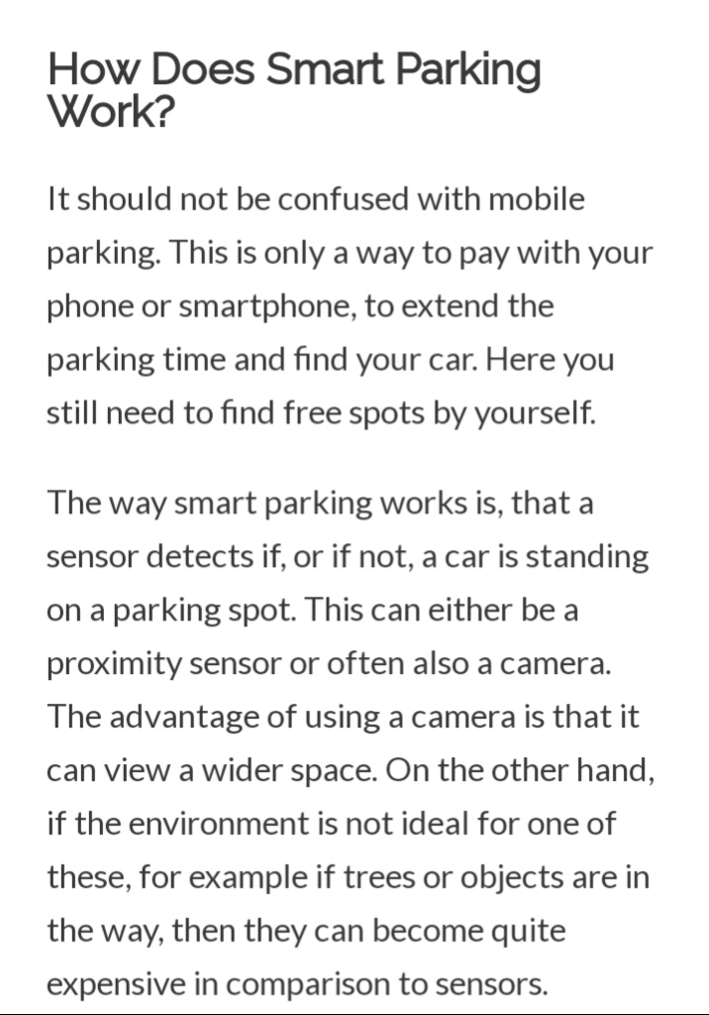
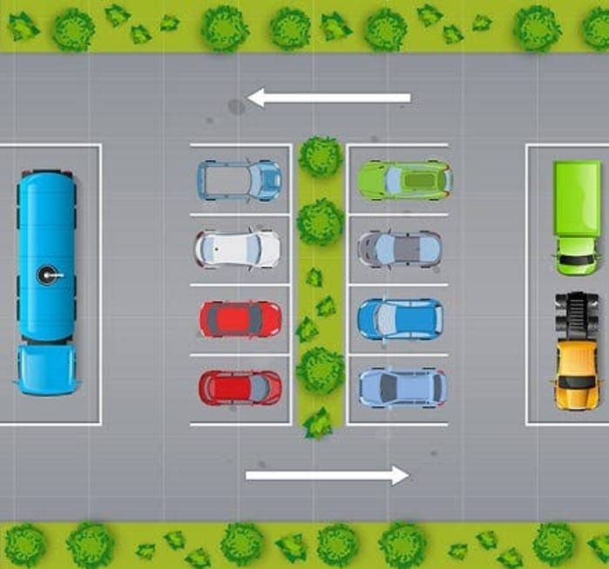

Slide 6
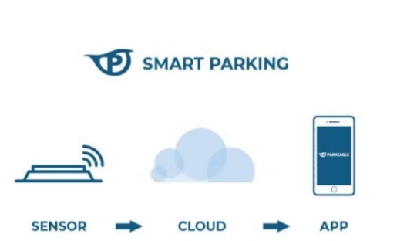

Slide 7
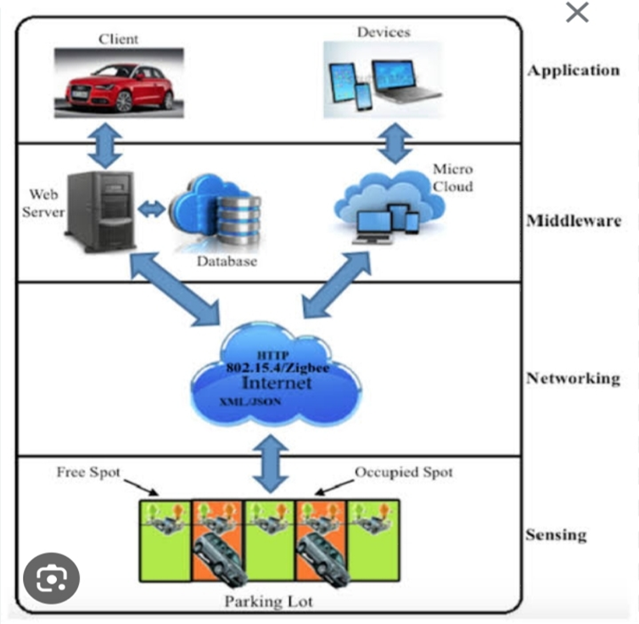

Slide 8
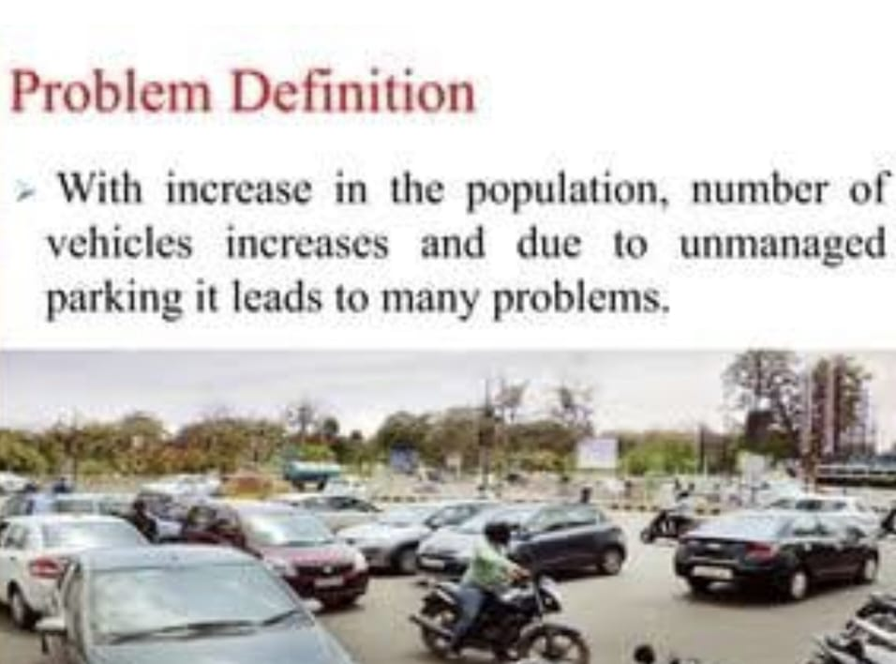

Slide 9
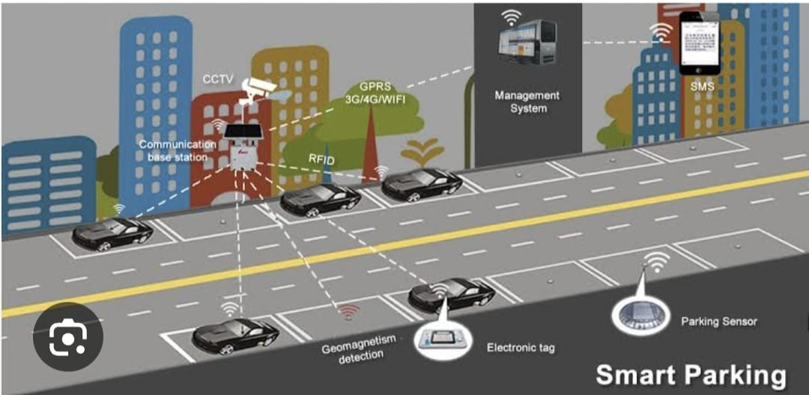

Slide 10


Slide 11
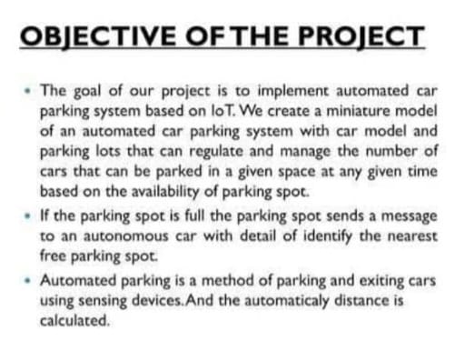
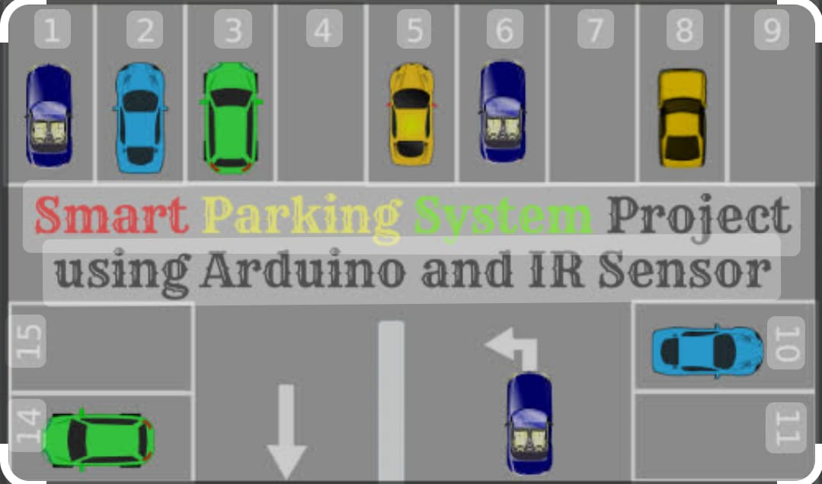

Slide 12
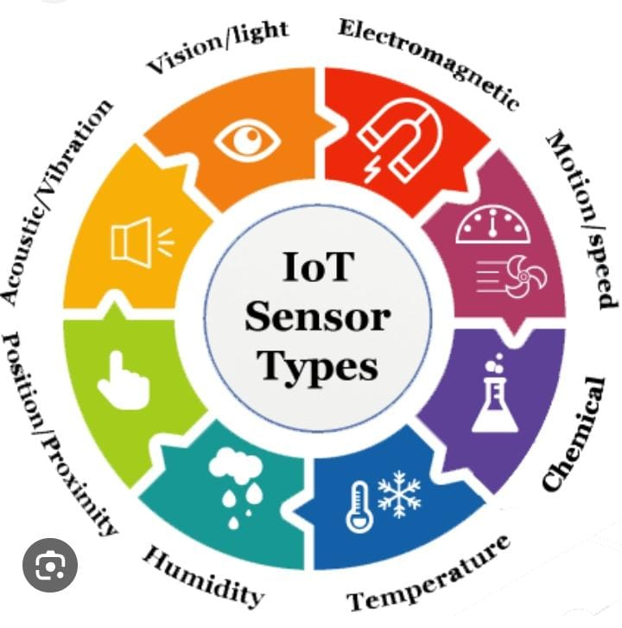

Slide 13
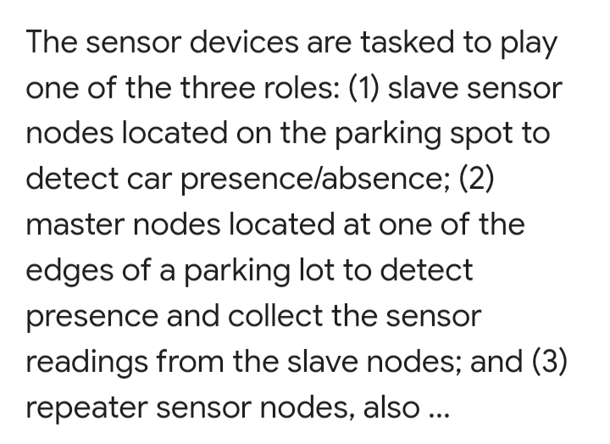
IOT SENSOR DESIGN:

Slide 14
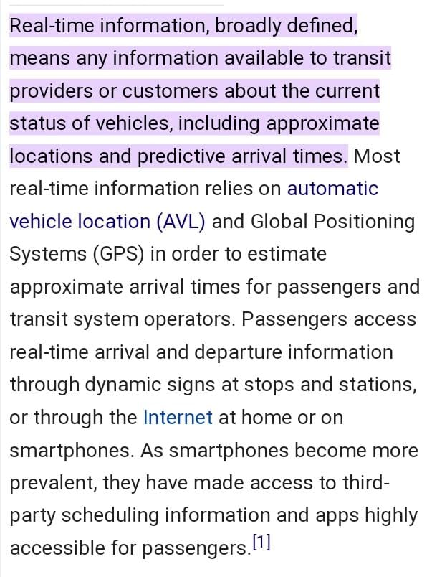
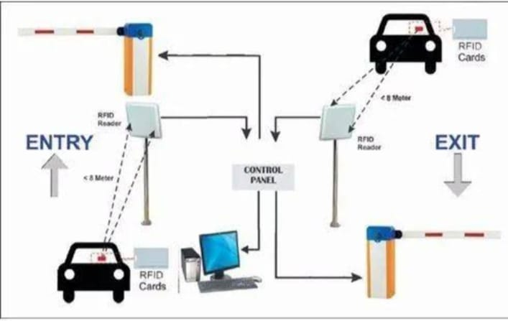
REAL-TIME TRANSIT INFORMATION PLATFORM:

Slide 15
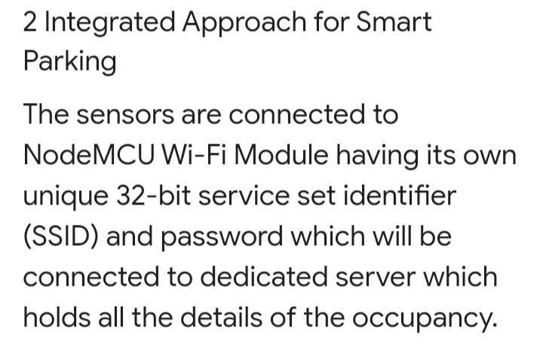
INTEGRATION APPROACH:

Slide 16
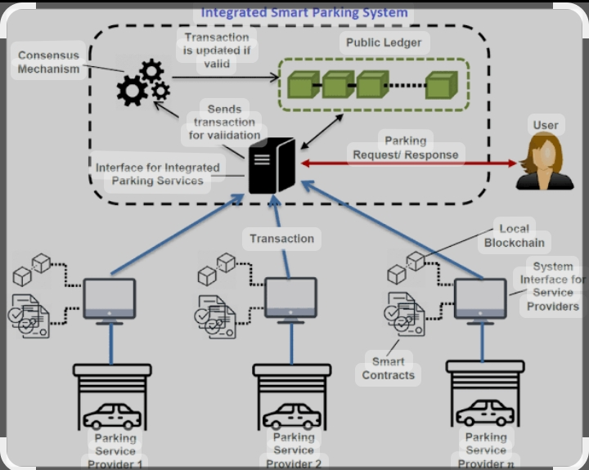

Slide 17
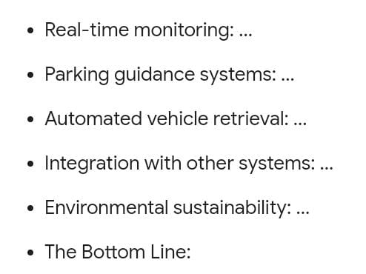
FEATURES OF SMART PARKING:

Slide 18
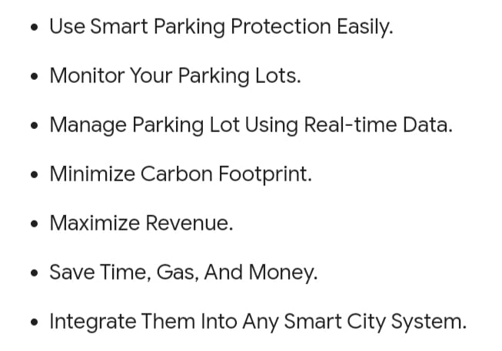
ADVANTAGES OF SMART PARKING:

Slide 19
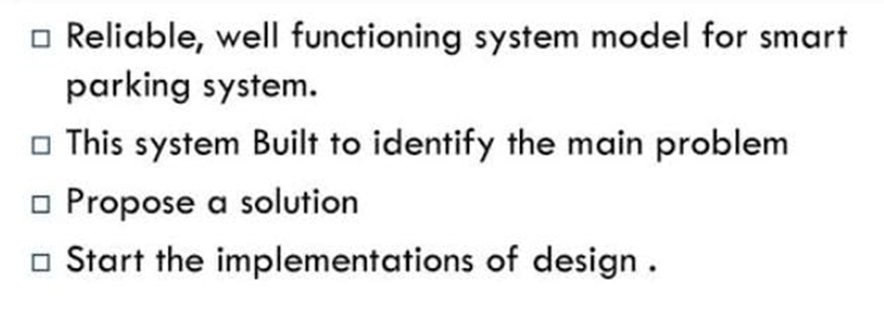
CONCLUSION:

Slide 20
PRESENTED BY:
ROSHINI.M
KOWSALYA.M
RENUGA.K
BHARATHI.S
MOULIKA.S

Slide 21
THANK
YOU

